Slide 1
Date: 07/05/2018
WELCOME
Mid Project Defense on
E-Client
(A perfect Client Management Tool (CMT))
By:
Oscar Garbuja : 2015-1-53-0122
Prabhu Gurung : 2015-1-53-0124
Pradeep Poudel : 2015-1-53-0125
Pradip Dhakal : 2015-1-53-0126

Slide 2
1
Project Time Period
10 Days
7 Days
23 Days
10 Days
10 Days
Feasibility Study
Wireframe / Interface
System Development
System Testing
Implementation

Slide 3
2
Progress Till Now
a. GANTT Chart
b. Prototype Design
c. Design & Development
d. Flowchart / Data Flow Diagram
e. Remaining task
4
5
6-11
12-15
16

Slide 4
3
Progress Till Now
a. GANTT Chart

Slide 5
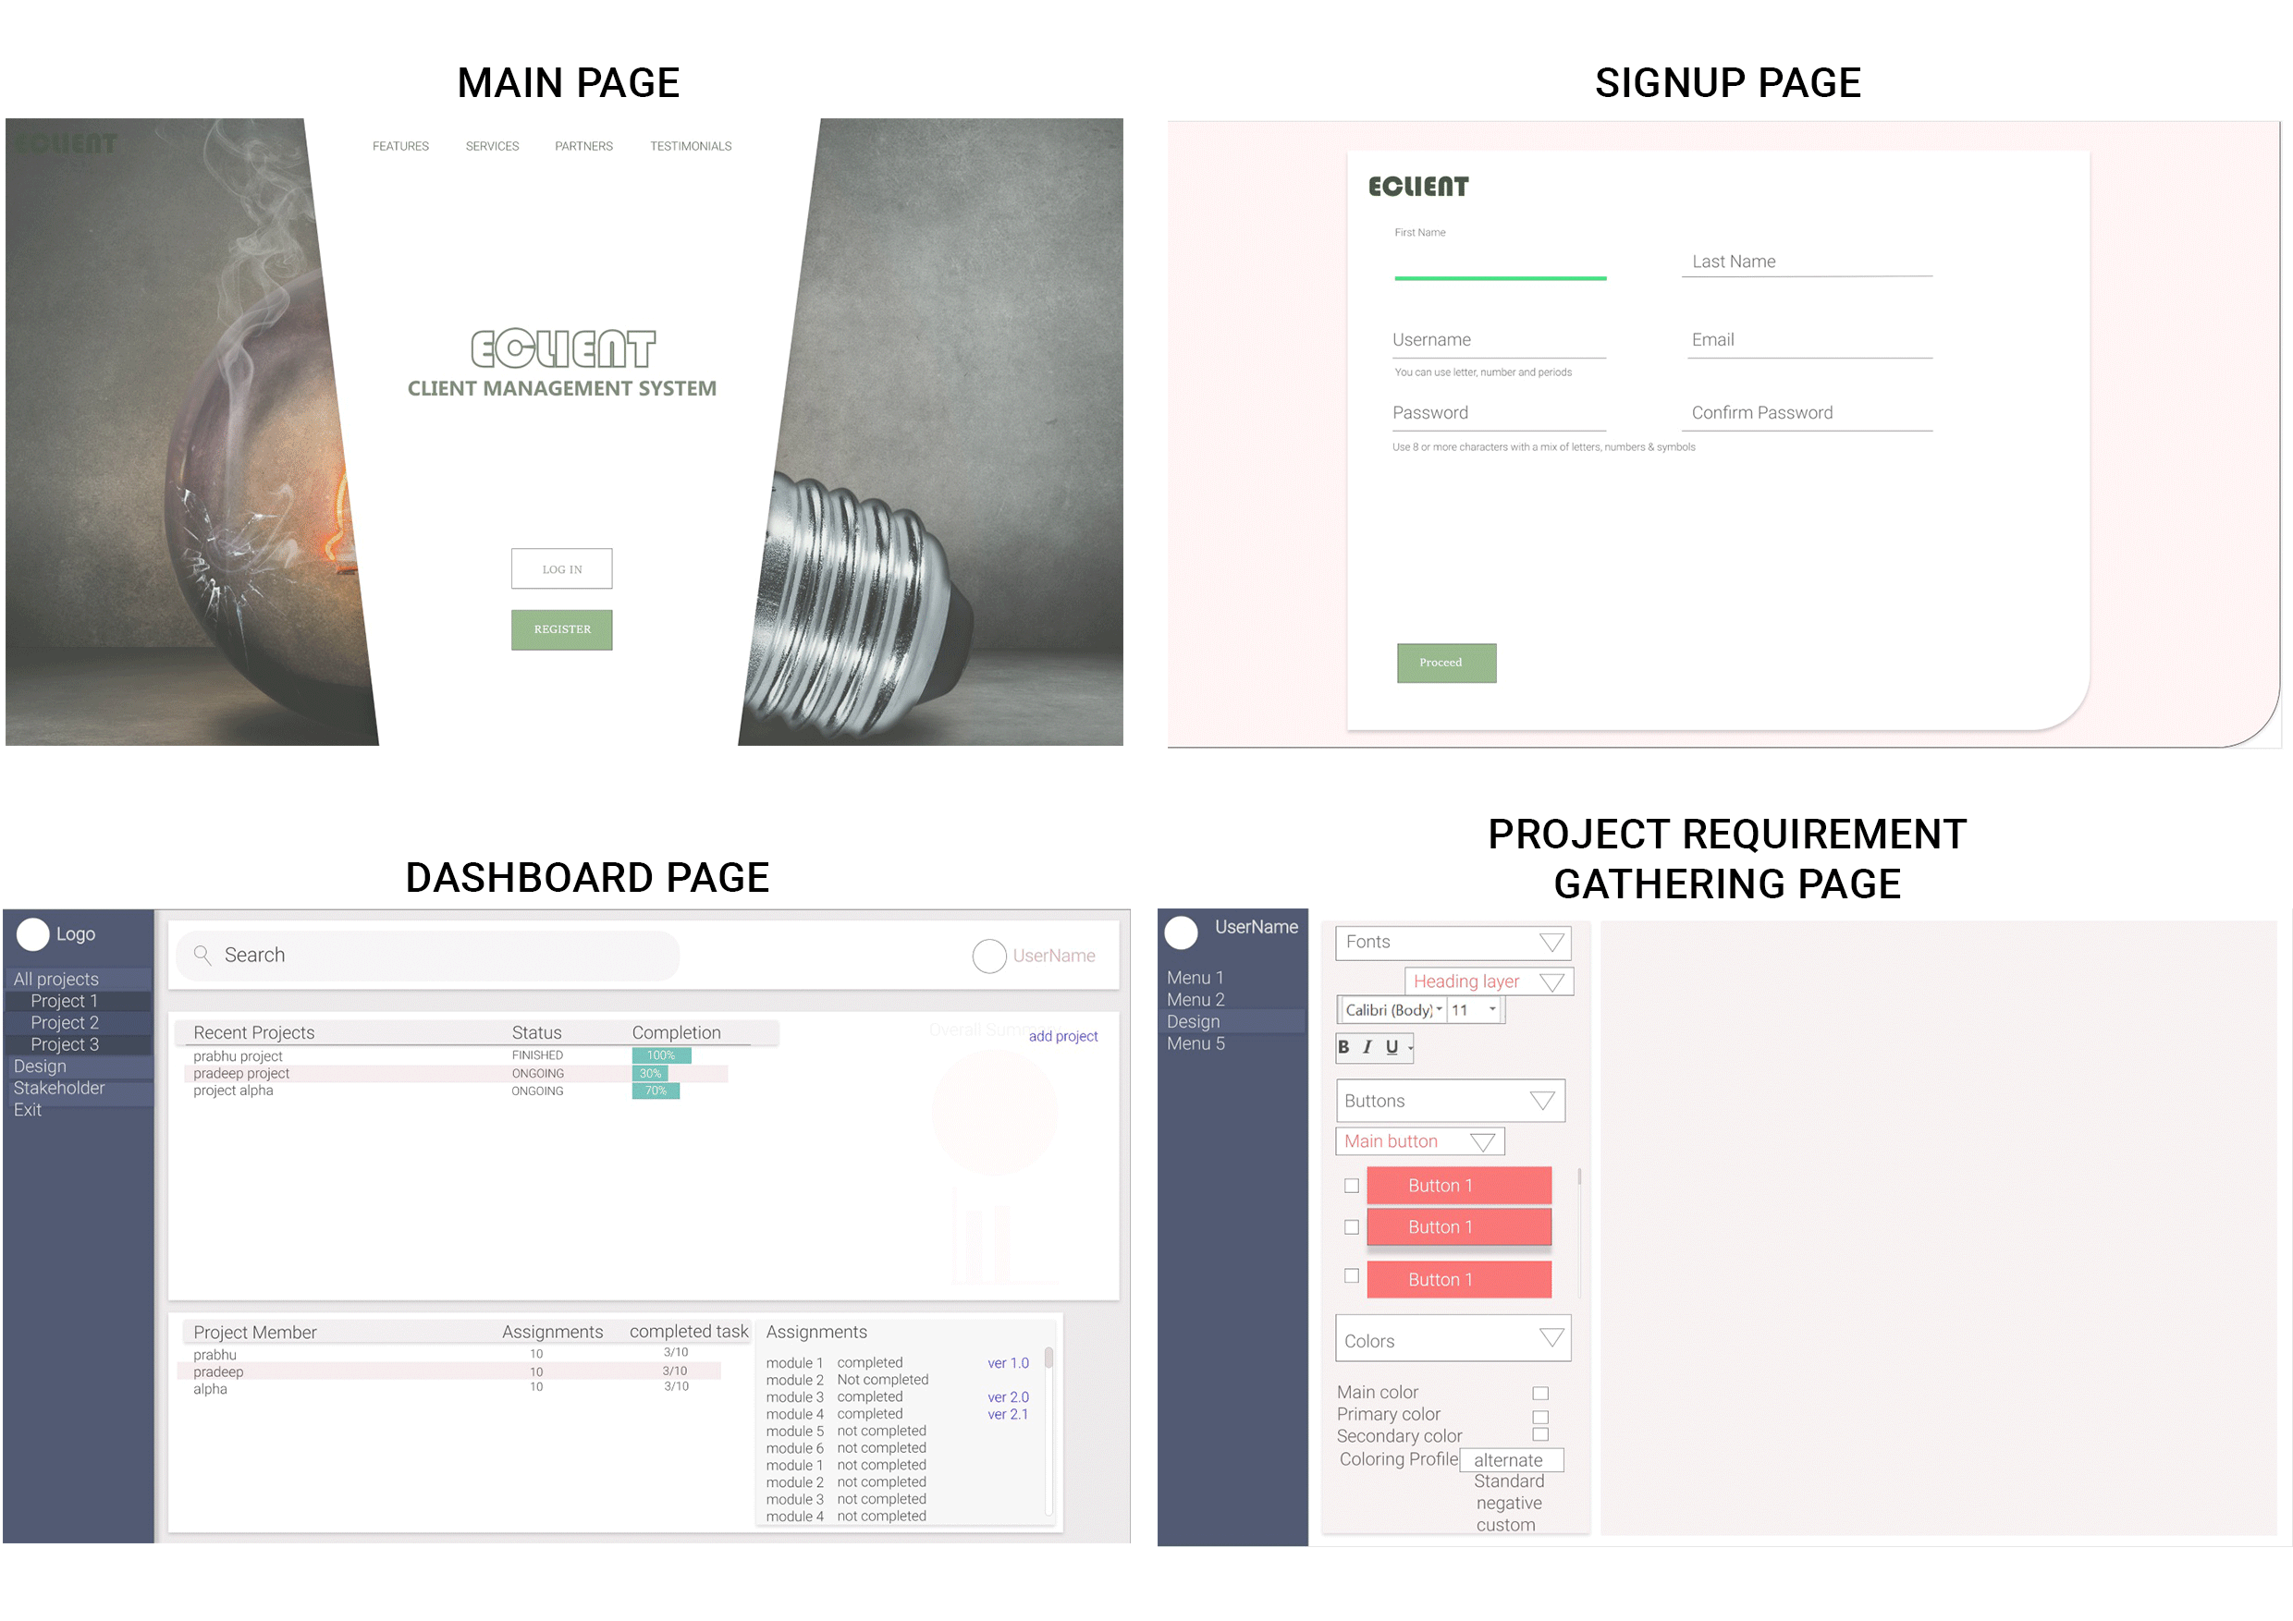
4
Progress Till Now
b. Prototype Design
For more detail:
https://xd.adobe.com/view/83aac8e7-5e13-4fe8-5825-36f124a281d9-f59b/

Slide 6
5
Progress Till Now
c. Design & Development
i. Front-End Design
- HTML / CSS(materialize CSS)
- javascript(jquery)

Slide 7
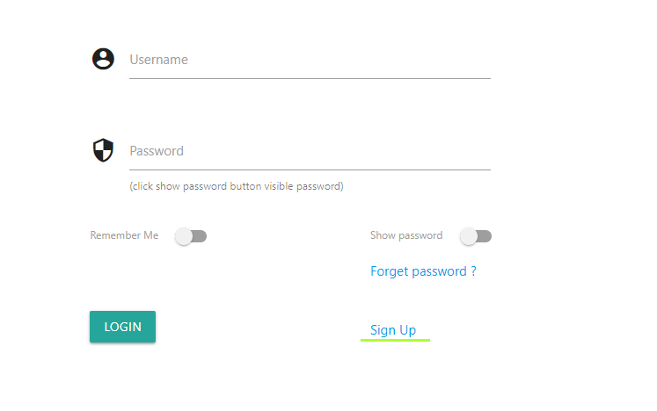
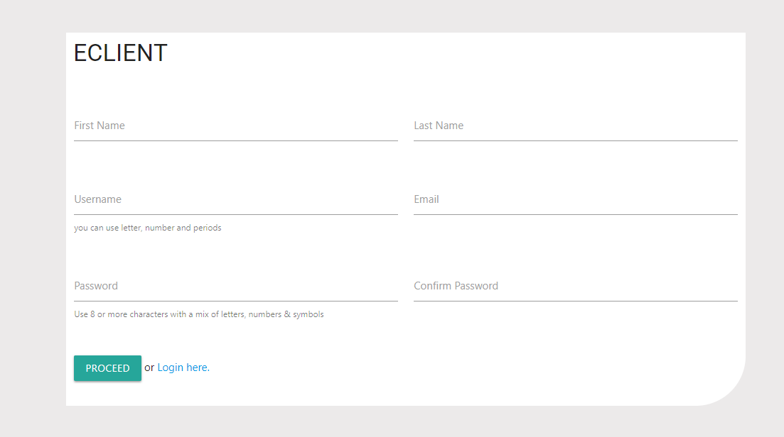
6
Progress Till Now
i. Front-End Design
Login Page
SignupPage

Slide 8

7
Progress Till Now
i. Front-End Design
Main Page

Slide 9
8
Progress Till Now
c. Design & Development
ii. Back-End Development
- PHP(tokbox SDK)
- mySQL

Slide 10
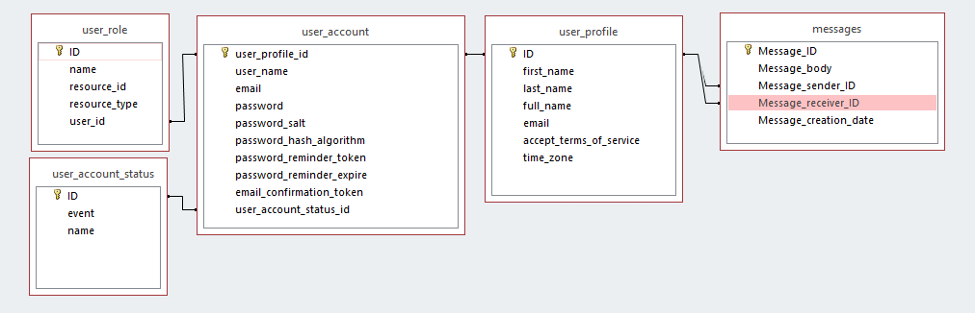
9
Progress Till Now
ii. Back-End Design / Development
1. User Database Schema

Slide 11
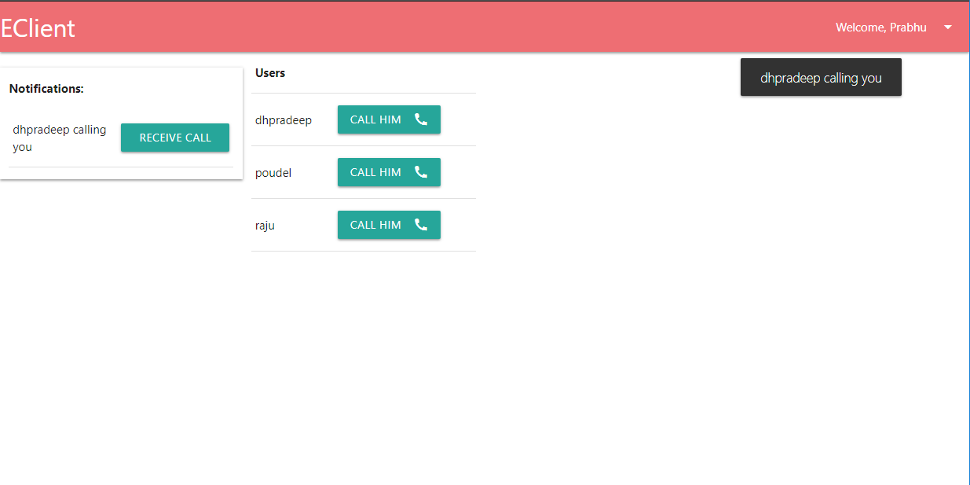
10
Progress Till Now
ii. Back-End Design / Development
2. Communication

Slide 12
11
Progress Till Now
ii. Back-End Design / Development
3. Backend Handling
3.a Backend library
-Authentication
- = ($conn->is_logged_in($username,$password))
CRUD Operation
= ($conn->insert($table, fieldsarray))
Security
= (hash/salt/md5/token)

Slide 13
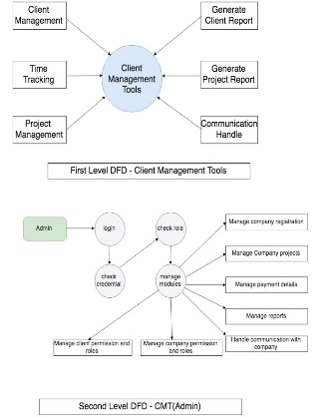
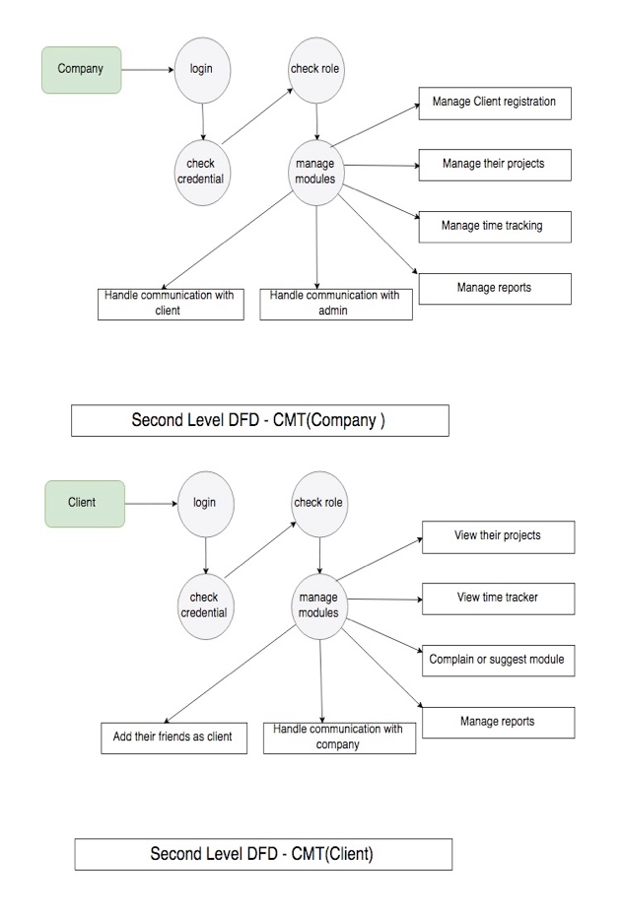
12
Progress Till Now
d. Data Flow Diagram

Slide 14
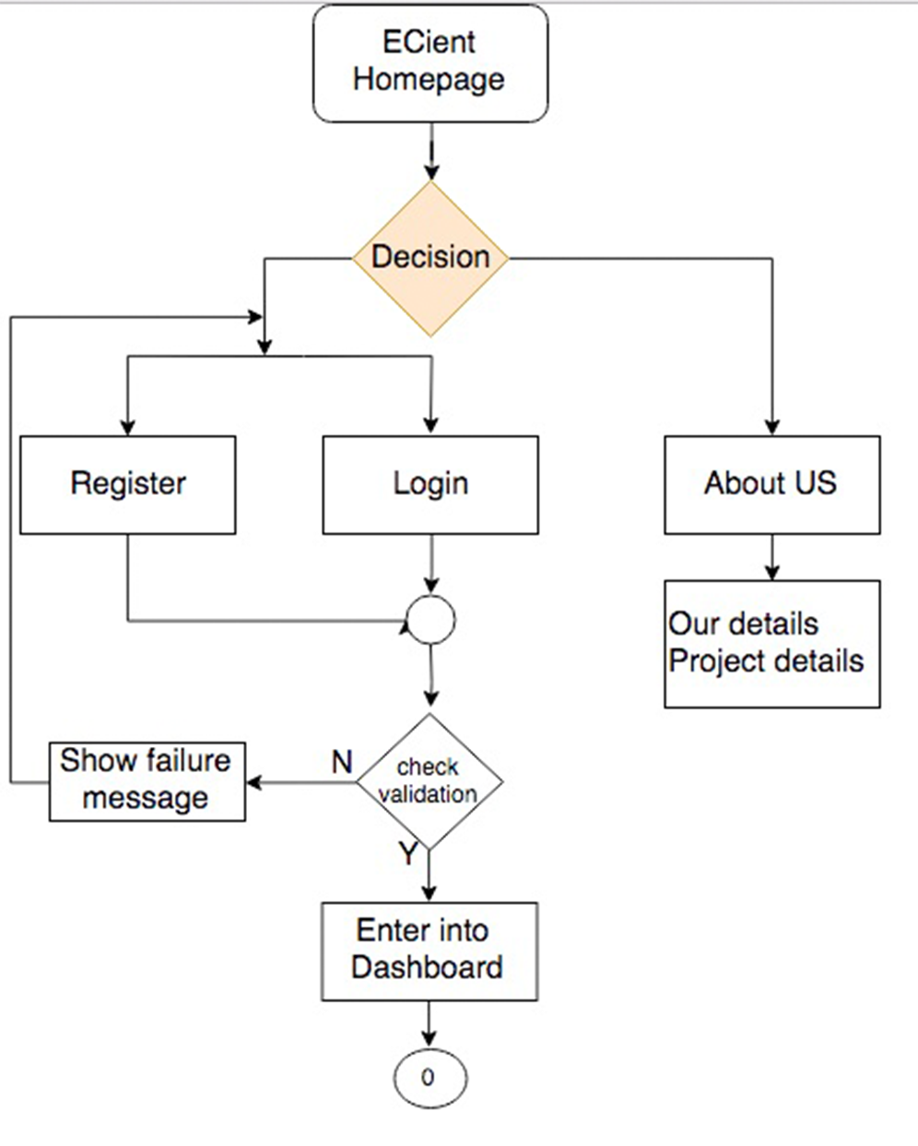
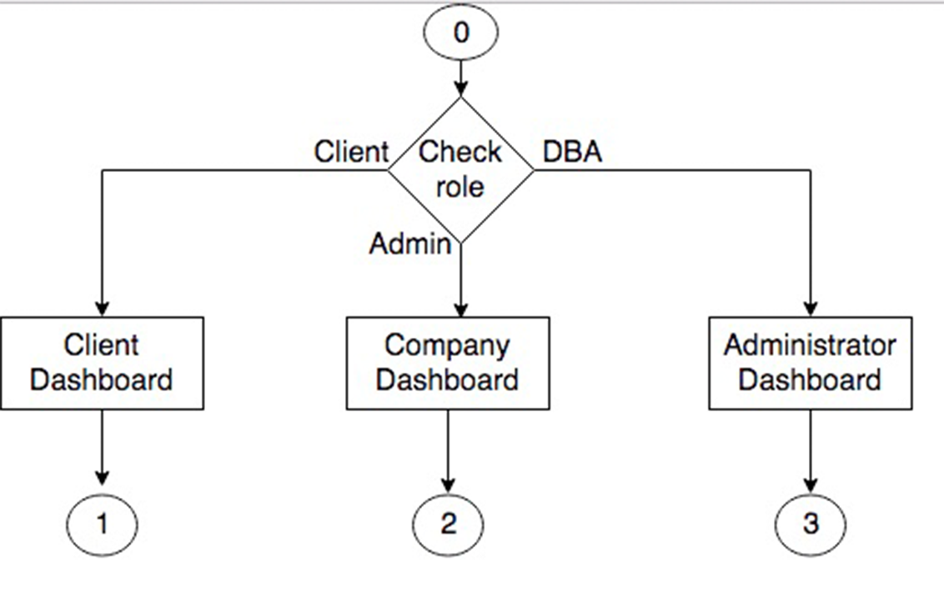
13
Progress Till Now
d. Flowchart

Slide 15
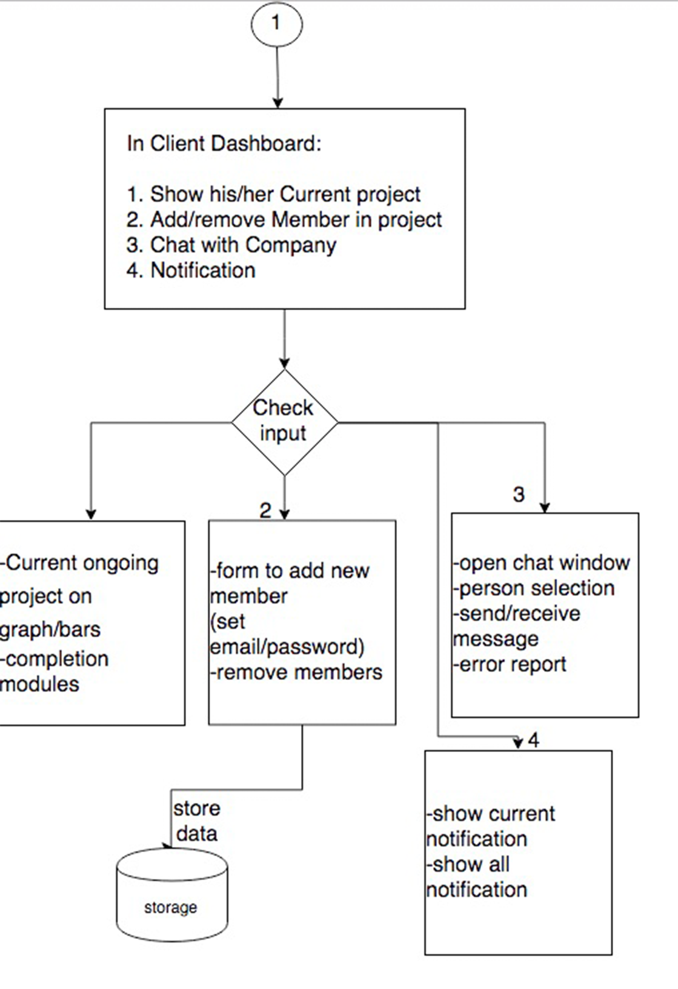
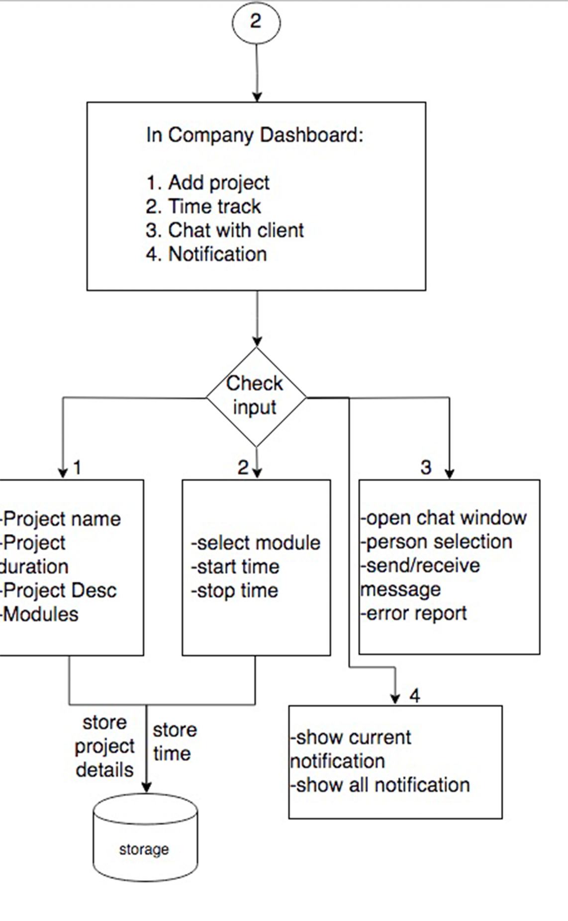
14
Progress Till Now
d. Flowchart

Slide 16
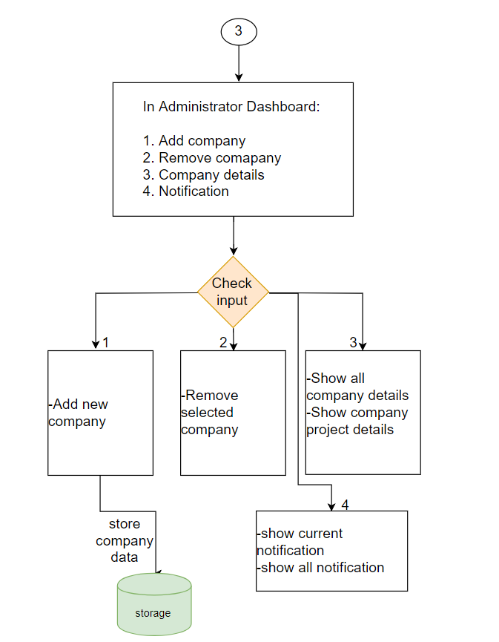
15
Progress Till Now
d. Flowchart

Slide 17
16
e. Task Remaining
1. Front-End:
a. Dashboard
2. Back-End:
a. Normalization in Database
b. To get requirement from Client (Requirement gathering tool)
c. Accessibility control (System to Handle Different Client specified role to their team members).
3. Documentation:
a. Well clean and easy to read guide to use it.

Slide 18
Thank You
For your Attendance
ANY QUESTIONS ?

